Slide 1

Agenda
Introduction to Keras
Implementation of ANN using Keras
What is a CNN (equivalence to human brain)?
Why CNN?
Layers of CNN
Convolutional Layer
ReLU Layer
Pooling Layer
Flattening Layer
Fully Connected Layer
Summing it up
Sample Implementations
CIFAR 10
Cats & Dogs

Slide 2
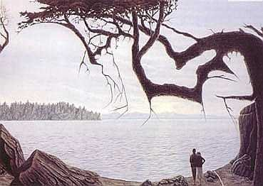

Slide 3
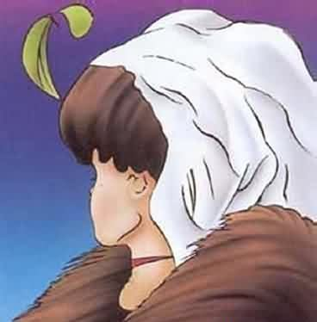

Slide 4
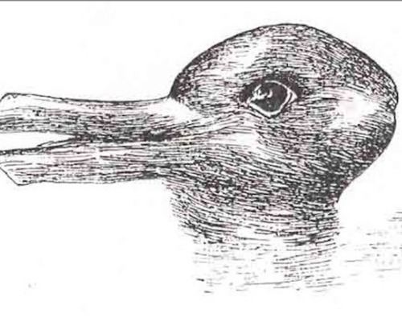

Slide 5
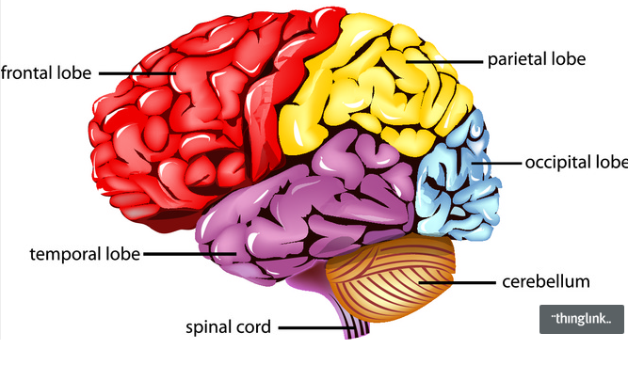

Slide 6
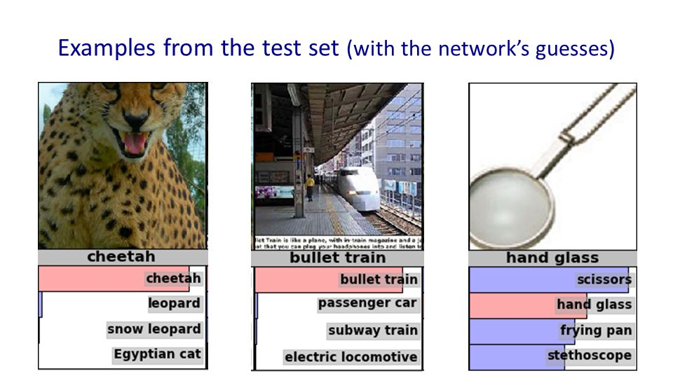

Slide 8

Convolution Layer

Slide 9
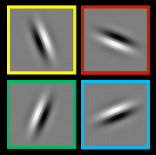
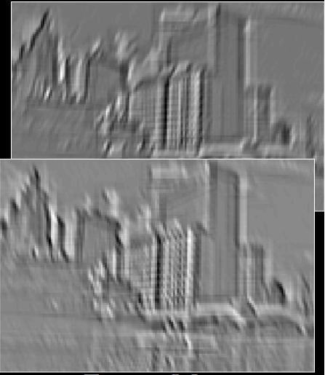
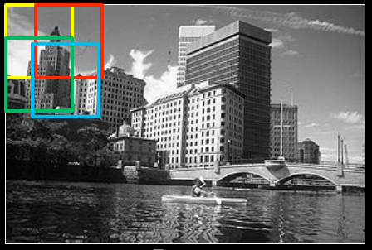
Filters
Input Image
Feature Maps

Slide 10
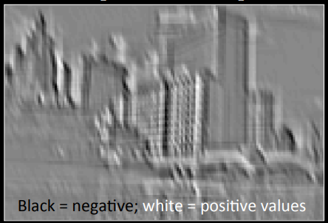
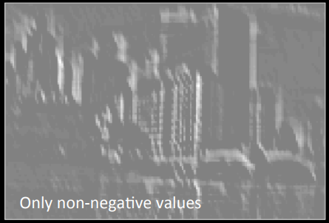
Input Feature Map
ReLU
Output Feature Map

Slide 11
